Slide 1
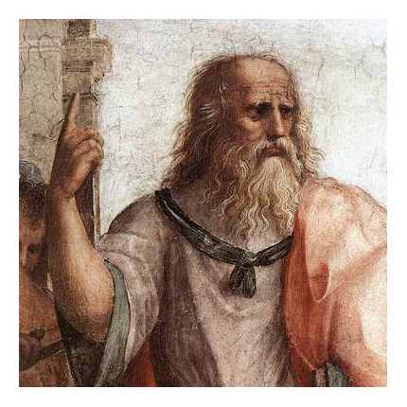
HUMA2921 Ethical Theories and Contemporary Issues
Prof. Plato Tse
NCCU & HKUST

Slide 2
Consequentialism
Thress Theses:
Value is independent of the right.
Explanatory priority of value
Personal value alone as relevant
Which theory of value?
How is right action related?

Slide 3
Classical Utilitarianism
Act Utilitarianism
A maximizing conception of right action
Right=greatest total amount of value
Welfarism
Welfare=fundamental value
Universalism
Welfare of all individuals affected count
Impartialism
Agent-neutral

Slide 4
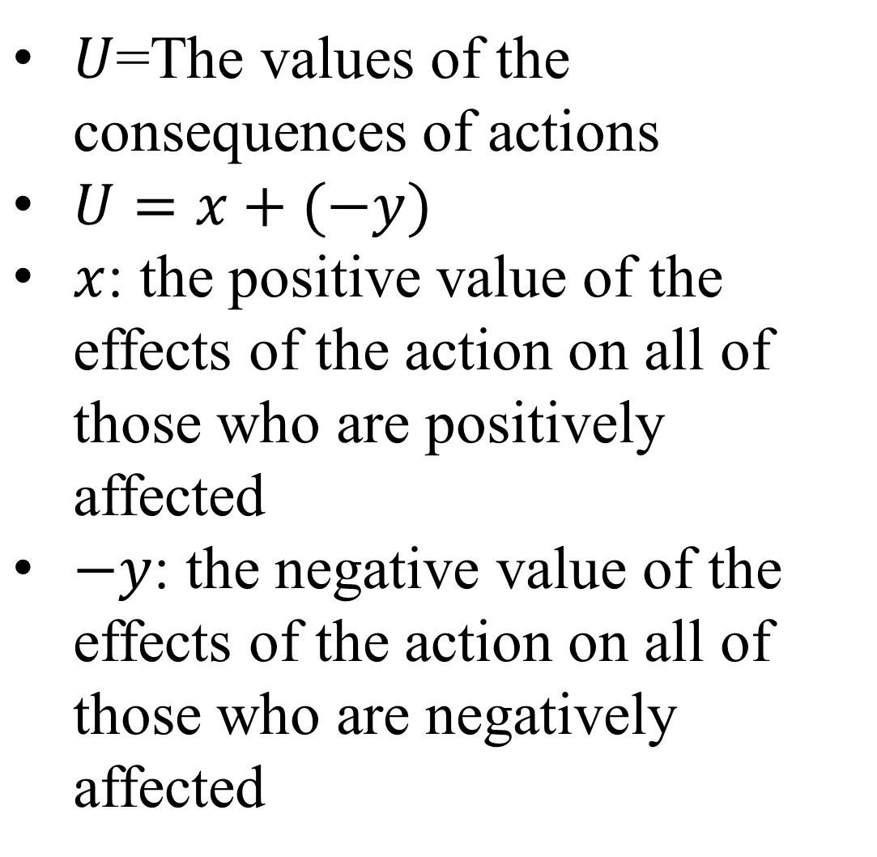
Utility
$U$=The values of the consequences of actions
: the positive value of the effects of the action on all of those who are positively affected
$−y$: the negative value of the effects of the action on all of those who are negatively affected

Slide 5
Theory of Right Conduct
An action A performed in circumstances C is obligatory iff doing A in C would produce a higher level of utility than would any other alternative action that the agent could perform instead.
An action A is wrong iff doing A in C would produce less utility than would some other alternative action that the agent could perform instead.
An action A is optional iff in terms of utility production it is tied for first place with at least one other action.

Slide 6
Generic Principle of Utility
An action A in C is right iff doing A in C would produce as high a utility as would any alternative action that the agent could perform instead.

Slide 7
Hedonistic Utilitarianism
Jeremy Bentham and J. S. Mill accept the following two claims:
One’s (how one is faring in life) is a matter of one’s level of happiness.
Happiness is constituted by experiences of pleasure (and the absence of experiences of pain).
Pleasure: intrinsically good; pain: intrinsically bad.

Slide 8
Hedonistic Utilitarianism
Ethical Hedonism (EH):
Experiences of pleasure are intrinsically good, and experiences of pain are intrinsically bad, and they are the only items of intrinsic value with which ethics is concerned.
Principle of Hedonistic Utilitarianism (PHU):
An action A in C is right iff doing A in C would produce at least as high an overall balance of pleasure versus pain as would any other alternative action open to the agent.

Slide 9
Bentham’s Felicific Calculus
In An Introduction to the Principles of Morals and Legislation (1789), Bentham includes the following checklist of features to be used in calculating the utilities of actions:
Intensity
Duration
Certainty and uncertainty
Propinquity and remoteness
Fecundity
Purity
Extent

Slide 10
Mill’s Utilitarianism
John Stuart Mill (1806-1873) refined the position by considering qualitative facts about the nature of pleasure.
“It is quite compatible with the principle of utility to recognize the fact, that some kinds of pleasure are more desirable and more valuable than others. It would be absurd that while, in estimating all other things, quality is considered as well as quantity, the estimation of pleasures should be supposed to depend on quantity alone. (Mill [1863] 1979, 8)”

Slide 11
Mill’s Utilitarianism
“If I am asked, what I mean by difference in quality of pleasures, or what makes one pleasure more valuable than another…there is but one possible answer. Of two pleasures…If one of the two is, by those who are competently acquainted with both, placed so far above the other that they prefer it, even though knowing it to be attended with a greater amount of discontent, and would not resign it for any quantity of the other pleasure which their nature is capable of, we are justified in ascribing to the preferred enjoyment a superiority in quality, so far outweighing quantity as to render it, in comparison, of small amount. (Mill [1863] 1979, 8–9)”

Slide 12
Two Objections to Qualitative Hedonism
Obj. 1
Either quality has to do with the intrinsic nature of mental states of pleasure, or it does not.
If it does, then the only basis for distinguishing various pleasures is their intensity and duration. → back to pure quantitative hedonism.
If it does not, then Mill has actually forsaken hedonism.

Slide 13
Two Objections to Qualitative Hedonism
Obj. 2
Presumably, to be competent in judging matters of quality, one must have the developed capacities to enjoy the types of pleasures to be ranked.
But how can Mill be so sure that “expert judges” will reach universal or nearly universal agreement over matters of quality?

Slide 14
Mill’s “Proof”
Although Mill agrees that “questions of ultimate ends do not admit of proof” (Mill [1863] 1979, 34), we may still present considerations that determine the intellect to give assent to the doctrine.
Mill’s three-stage proof:
Each person’s happiness is intrinsically good to that individual.
The general happiness (the happiness of all individuals) is an intrinsic good to the aggregate of individuals.
Happiness is the only intrinsic good.

Slide 15
Mill’s “Proof”
Stage 1:
People desire their happiness for its own sake.
If something is desired for its own sake, then it is desirable as such.
Each person’s happiness is desirable as such to that person.
If something is desirable as such, then it is intrinsically good (by definition).
Therefore, one’s happiness is an intrinsic good to oneself.

Slide 16
Stage 2:
One’s happiness is an intrinsic good to oneself (conclusion of stage 1).
If each person’s happiness is an intrinsic good to that person, then general happiness is intrinsically good to the aggregate of persons.
Therefore, general happiness is an intrinsic good to the aggregate of persons.
Mill’s “Proof”

Slide 17
Mill’s “Proof”
Merely saying that happiness is an intrinsic good is not sufficient to secure the utilitarian position.
Happiness is the only thing of intrinsic value.
Stage 3:
All other things besides happiness that are desired for themselves are only desired as parts of the end of happiness.
Therefore, happiness is the sole intrinsic good.

Slide 18
Stage 1:
Fallacy of Equivocation
At least two meanings of “desirable”: “able to be desired” and “worthy of being desired”. Analogy:
Philosophy is an art.
Art is studied by art historians.
Philosophy is studied by art historians.
“Capable of being desired” does not necessarily imply “worthy of being desired.”
Diagnosing
Mill’s “Proof”

Slide 19
Diagnosing Mill’s “Proof”
Stage 2:
Fallacy of Composition
Suppose a machine is made up of parts.
Each part weighs less than five pounds.
Does it follow that the machine must also weigh less than five pounds?

Slide 20
Stage 3:
It is not clear how things that are desired in and for themselves are a part of the end of happiness.
“The ingredients of happiness are very various, and each of them is desirable in itself, and not merely when considered as swelling an aggregate. The principle of utility does not mean that any given pleasure, as music, for instance, or any given exemption from pain, for example, health, is to be looked upon as means to a collective something termed happiness and to be desired on that account. They are desired and desirable in and for themselves; besides being means, they are a part of the end. Virtue, according to the utilitarian doctrine, is not naturally and originally part of the end, but it is capable of becoming so. (Mill [1863] 1979, 35–36)”
Diagnosing
Mill’s “Proof”

Slide 21
Practical Objections
Problem of Ignorance
To apply PHU in a concrete situation, one would have to figure out the utilities of all the available alternative actions.
Ignorant of the outcomes/without access to the experiences of others, the calculation is not feasible.
Possible response: the principle of utility is intended as a moral criterion, not a decision procedure.

Slide 22
ECU: An action A in C is right iff doing A in C has as high an expected utility as any alternative action that the agent could perform instead.
Thought experiment shows that both versions exert their pull on us in different scenarios.
Actual vs
Expected Consequences Utilitarianism

Slide 23
Actual vs Expected Consequences Utilitarianism
Mine Shafts (from Derek Parfit)
A hundred miners are trapped underground, with floodwaters rising.
There are three floodgates that we could close by remote control.
We know that all of these men are in one of two mine shafts, but we don’t know which.
On the evidence available, it is equally likely that the miners are all in shaft A OR all in shaft B.

Slide 24
The miners are in
 |  | Shaft A | Shaft B
Phil closes | Gate 1 | Save 100 lives | Saves no lives
 | Gate 2 | Saves no lives | Saves 100 lives
 | Gate 3 | Saves 90 lives | Saves 90 lives
Suppose that the miners are trapped in shaft A, but Phil doesn’t know this.
Expected utilities:
Closing gate 1: (0.5×100)+(0.5×0)=50
Closing gate 2: (0.5×0)+(0.5×100)=50
Closing gate 3: (0.5×90)+(0.5×90)=90
Actual vs
Expected Consequences Utilitarianism

Slide 25
Actual vs Expected Consequences Utilitarianism
It seems intuitively clear that Phil ought to close gate 3 and not take the risk of losing all 100 miners.
After closing gate 3, he finds out that the miners were actually trapped in shaft A.
Closing gate 3 saved 90/100, 10 lost their lives.
“I ought to have closed gate 1, and then all 100 would have been saved.”

Slide 26
SPU: An action A performed in circumstances C is (presumptively) subjectively right if (not iff!) the agent believes that A has as high an expected utility as does any of the available alternative actions that she believes are open to her in C.
The action judged to have the highest expected utility is subjectively obligatory, all others are subjectively wrong.
Subjective vs Objective Rightness of Actions

Slide 27
Subjective vs Objective Rightness of Actions
It seems intuitively clear that Phil ought to close gate 3 and not take the risk of losing all 100 miners.
After closing gate 3, he finds out that the miners were actually trapped in shaft A.
Closing gate 3 saved 90/100, 10 lost their lives.
“I ought to have closed gate 1, and then all 100 would have been saved.”

Slide 28
SPU formulates only a sufficient condition, not a necessary one.
Without beliefs about expected outcomes, the principle will not suffice as a guide.
It provides only a presumptively sufficient condition for an action’s being subjectively right.
In some cases, the presence of beliefs about expected outcomes does not warrant an act’s being subjectively right.
Constraints

Slide 29
Constraints
Suppose by closing gate 3 Phil can save only 50 of the 100 miners (regardless of where they are).
The expected utility associated with closing gate 3 would then become +50 [(0.5×50)+(0.5×50)=50], equal to the expected utilities of the other two options.
Does it mean that all three acts are subjectively right?
Intuitively, closing gate 3 is still the subjectively right act.

Slide 30
Blame-worthiness/ praise-worthiness ≠ objective wrongness/objective rightness
Considerations of moral praise and blame are sensitive to how morally conscientious a person is in choosing to perform an action.
Phil is not blameworthy, even though he performed an action that was objectively morally wrong.
Constraints

Slide 31
Constraints
Distinguish what one subjectively ought to do from what one objectively ought to do, and keeping in mind that blameworthiness is tied to the subjective notion of moral obligation, there can be
Cases of knowingly engaging in blameless wrongdoing
Cases of knowingly engaging in praiseless rightdoing

Slide 32
Not all situations allow for moral deliberation
Two levels of moral thought
Intuitive level
Proceeds according to moral rules that we learn early on
Critical level
Ordinary moral rules come into conflict and we must deliberate about what to do
Constraints

